Slide 1
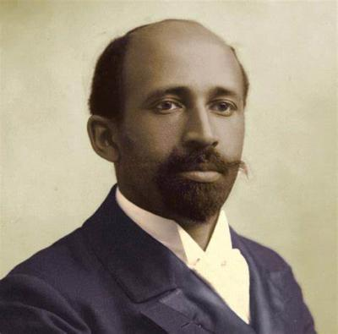

W.E.B Dubois
Habeeb Kotun Jr., Jessica Owens, Dario Perez Sade Graves, Ijeoma Njoku
Tuesday, April 29, 2025

Slide 2
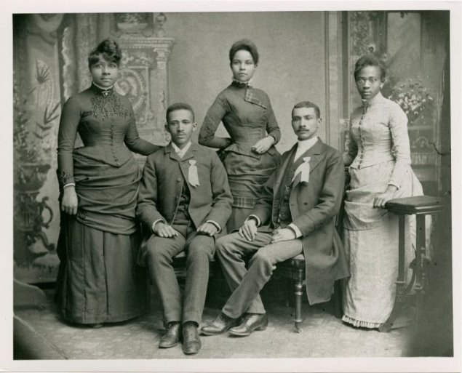
Background
Born February 23, 1868, in Great Barrington, Massachusetts
Earned a bachelor’s degree from Fisk University in 1888
Received a second bachelor’s degree (1890), master’s (1891), and became the first African American to earn a Ph.D. from Harvard University in 1895
W. E. B. DuBois with the Fisk University Class of 1888
7

Slide 3
Background cont.
Co-founded the NAACP in 1909 and served as the editor of its journal, The Crisis
Joined Alpha Phi Alpha Fraternity, Incorporated as an honorary member of the Epsilon Chapter at the University of Michigan in 1909, where he offered his endorsement and became a spiritual inspiration for the fraternity’s mission
7

Slide 4
What did they accomplish as an ethics hero?
Conducted pioneering empirical research with The Philadelphia Negro (1899), the first sociological case study of a Black community, proving social conditions—not race—cause disparities.
Created groundbreaking data visualizations for the 1900 Paris Exposition to showcase institutional racism and Black progress
Co-founded NAACP and edited The Crisis, promoting social change and ethical activism
7

Slide 5
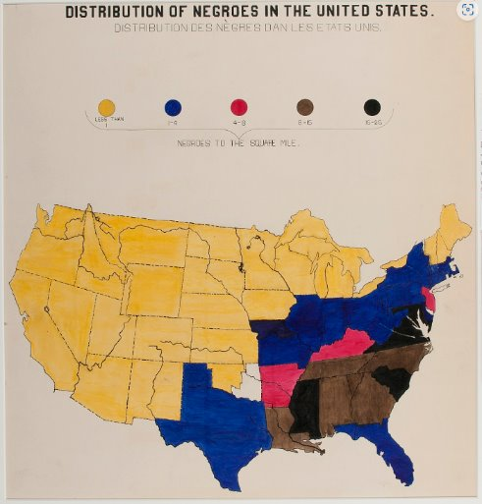
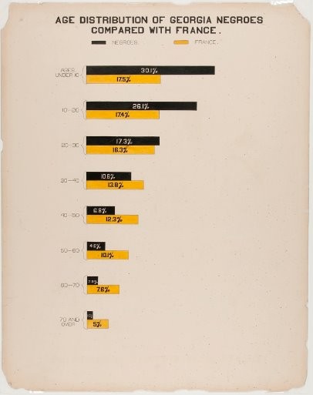
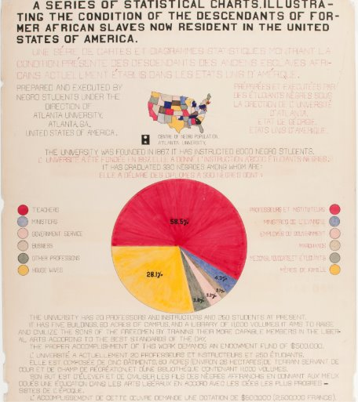
What did they accomplish as an ethics hero? cont.

Slide 6
Why is it important?
W.E.B Dubois fought for rights and concepts that is still relevant today. He stood for Equity, which African American people still do not have in all sectors of this society.
Used empirical research and statistics to reveal the realities of Black Americans, challenge racist assumptions, and influence public policy.
Continues to inspire researchers and advocates to use data and visualization for social impact and justice.
7

Slide 7
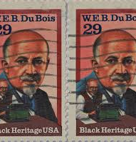
Why did you choose this person?
Pan-Africanist and advocated for the political economic and cultural unity of people of African descent
A pioneer in so many fields, founding the NAACP, and fighting scientific racism by asking the hard questions and including data that would include black people
He showcased a fusion of art and data and created many visualizations
"Capitalism cannot reform itself; it is doomed to self destruction

Slide 8
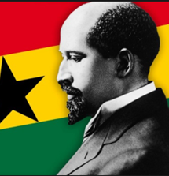
What are they doing now?
W.E.B. Du Bois passed away in 1963 in Ghana; moved there in solidarity with African independence movements
W.E.B. Du Bois’s legacy lives on through the W.E.B. Du Bois Memorial Centre in Ghana, ongoing academic events and symposia focused on his pioneering work in data and social justice, and continued inspiration for movements advocating racial equality and ethical data use worldwide.

Slide 9
References
https://www.hmdb.org/m.asp?m=182182
https://usafacts.org/articles/web-du-bois-hand-drawn-data-visualizations-black-americans/
https://nightingaledvs.com/w-e-b-du-bois-staggering-data-visualizations-are-as-powerful-today-as-they-were-in-1900-part-1/
https://nightingaledvs.com
https://techno-sapien.com/blog/web-dubois-datascience-art
7

